Slide 1

Rajkiya Engineering College,Bijnor
E-Medical Services
Presented By:
Shyama Gupta (1873513051)
Swati Rani (1907350139004)
Tanya Agrawal (1873513056)
Mentor:
Mr. Sudhir Goswami
(Assistant Professor)
(IT Department)

Slide 2

Outlines
Objective
Introduction
Problems
Benefits
Features and Proposed System
Software Requirements
Screenshots
Advantages
Conclusion
Future Scope
References

Slide 3
Objective
To develop a system through which patients can communicate with doctors from their comfort zone.
To replace current manual file keeping system with an online medical database.
To provide easy accessibility of services.

Slide 4
Introduction
To provide specialized health care consultation to patients in remote location.
It is web based application that allow individual/users to book appointments online through any web connected devices to facilitate chat, video-conferencing, expert panel among health care experts for better treatment and care.

Slide 5




Problems
Manual appointment booking.
Individual system to manage.
Non-availability of doctor’s for any particular specialist.
Waste of time by standing or waiting for doctors availability.

Slide 6





Benefits
Benefits to Manager
Benefits to Doctors
Benefits to Patients
Easy management of staff.
Easy invoicing.
Task integration.
Pre scheduling list.
Reduce manpower.
Patient history.
Easy scheduling.
Appointment list.
Focus on core activities.
Prescription.
24/7 online booking.
Confirmation.
Cancel / Rescheduling booking.
Less waiting time.

Slide 7

Features
Login for Admin, Doctors and Patients
Online Appointments
Individual and Expert Panel of Doctors
Video Conferencing
Online Prescription
Progress Tracking of Treatment
Patients Previous Records
Contact Us
Feedback

Slide 8
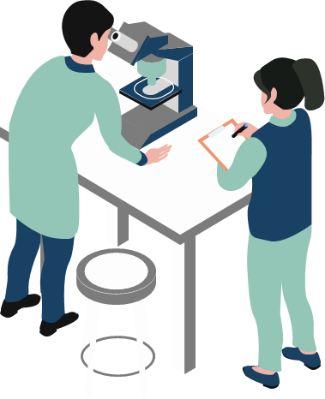
Proposed System
We have designed an “Expert Panel” of Doctors in which a patient can interact with two or more number of doctors at a time.
“WhatsApp Chat” is introduced in this system in order to provide chat communication between doctor and patient.

Slide 9







Software Requirements
Frontend | HTML5, CSS3,JavaScript,jQuery
Backend | PHP
Database | MySQL
IDE | Visual Studio Code

Slide 10
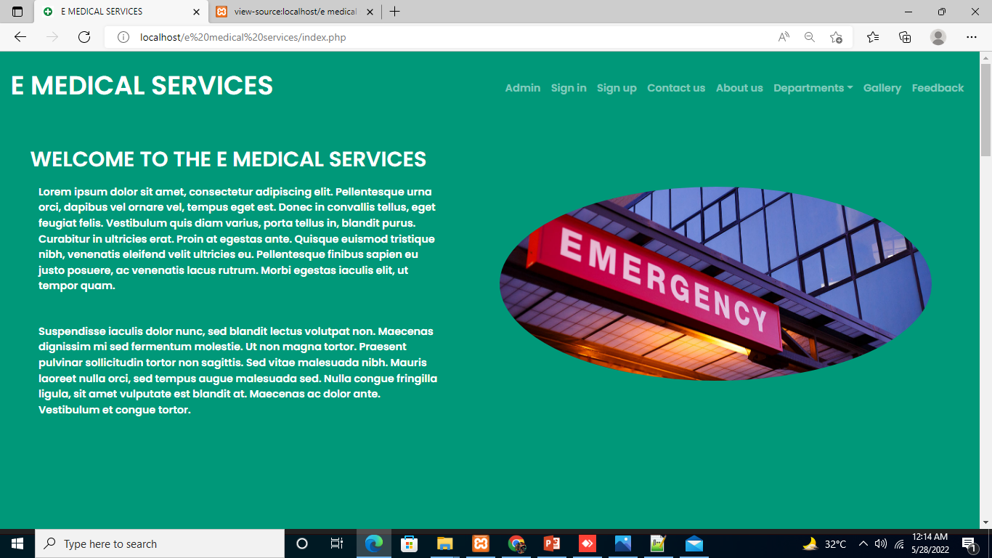
Screenshots

Slide 11
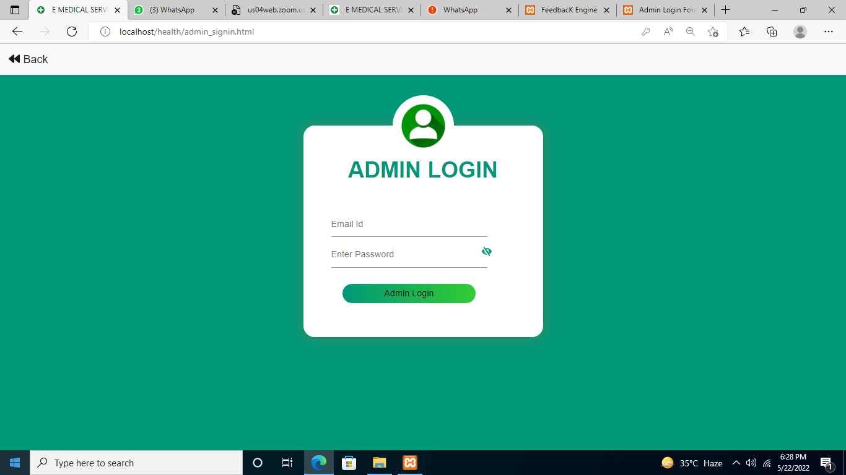
Admin Login

Slide 12
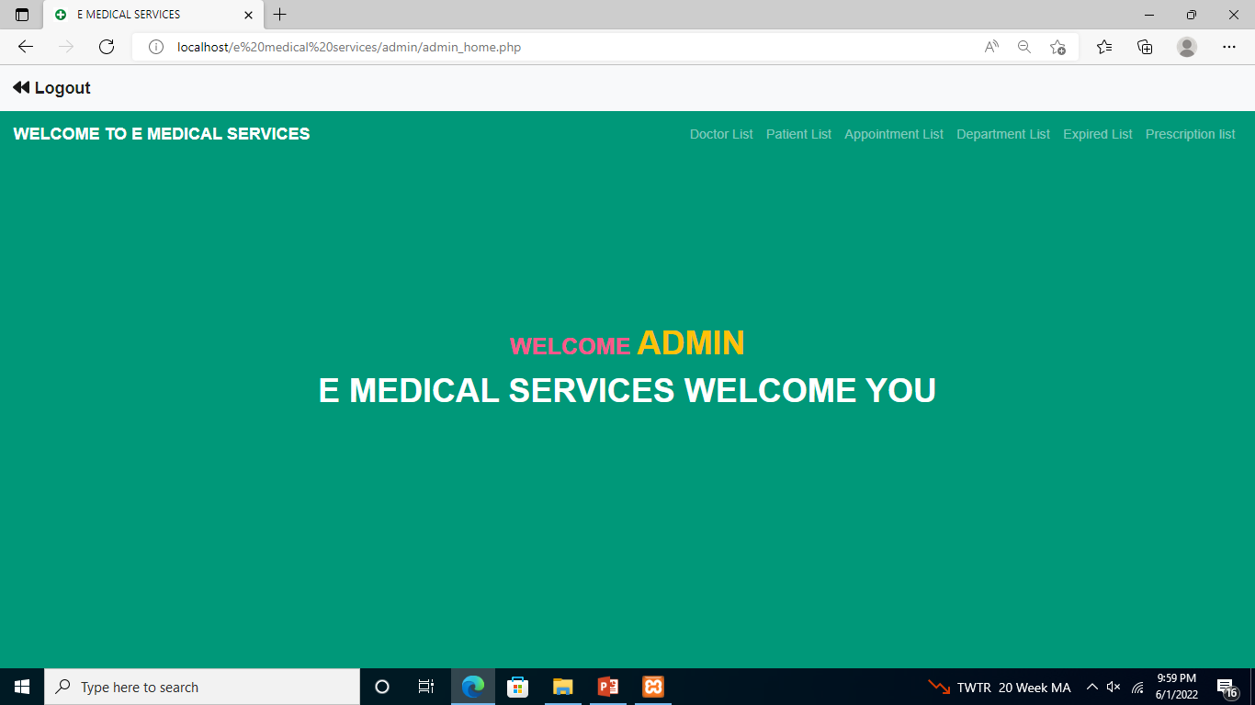
Admin Portal

Slide 13
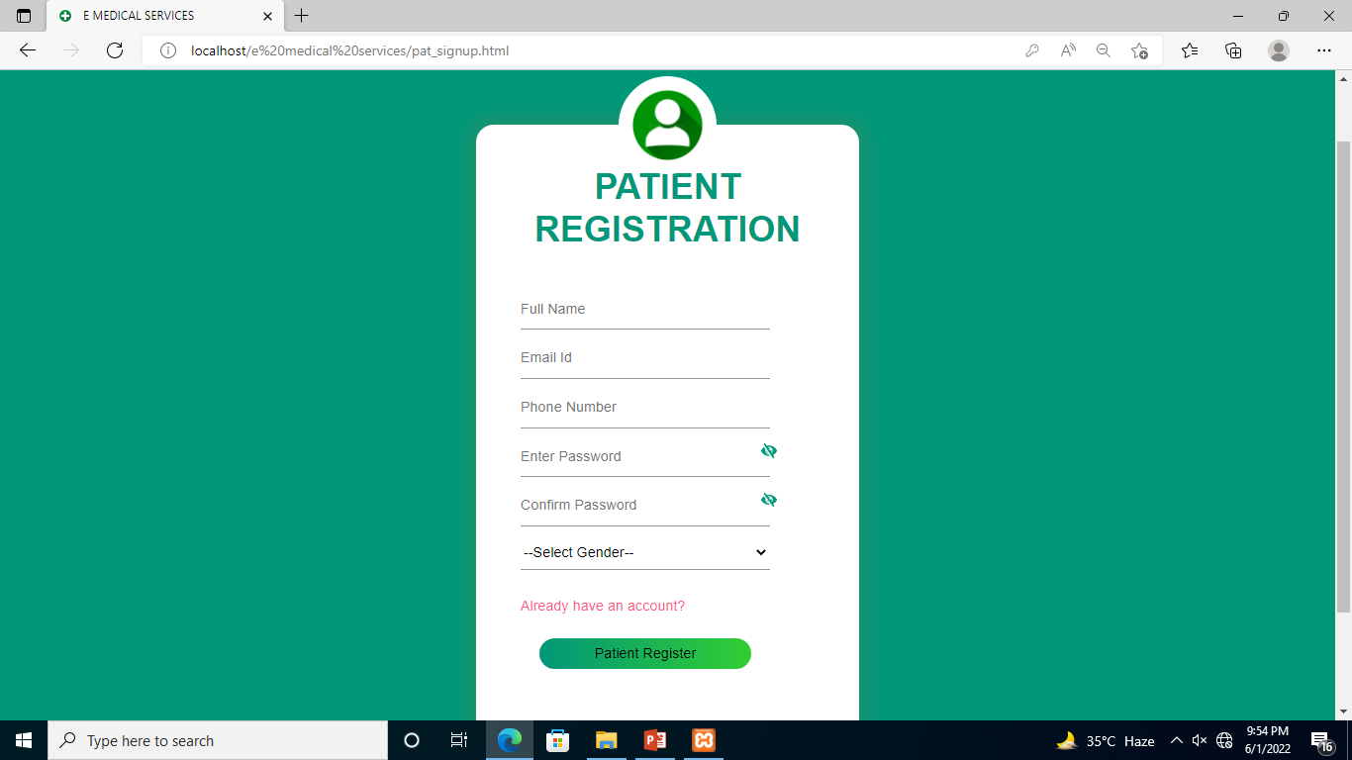
Patient Signup

Slide 14
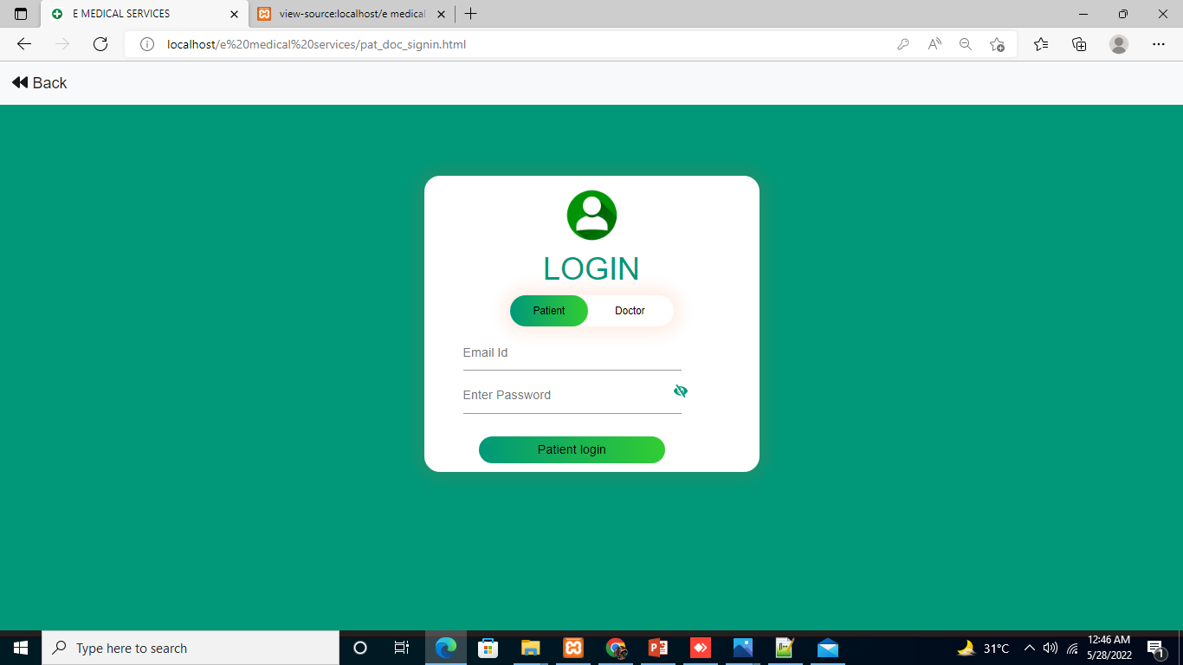
Patient and Doctor Login

Slide 15

Patient Portal

Slide 16
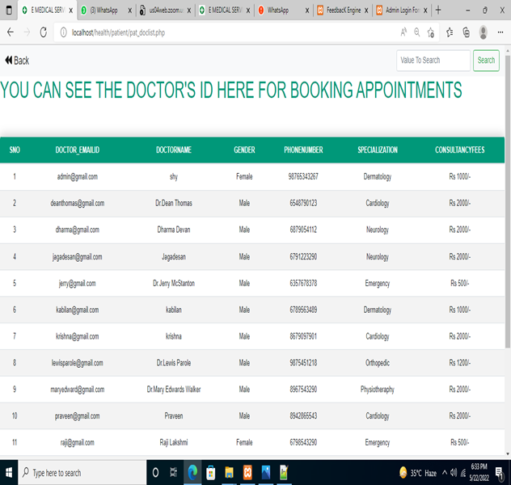
Doctor’s List for Appointment

Slide 17
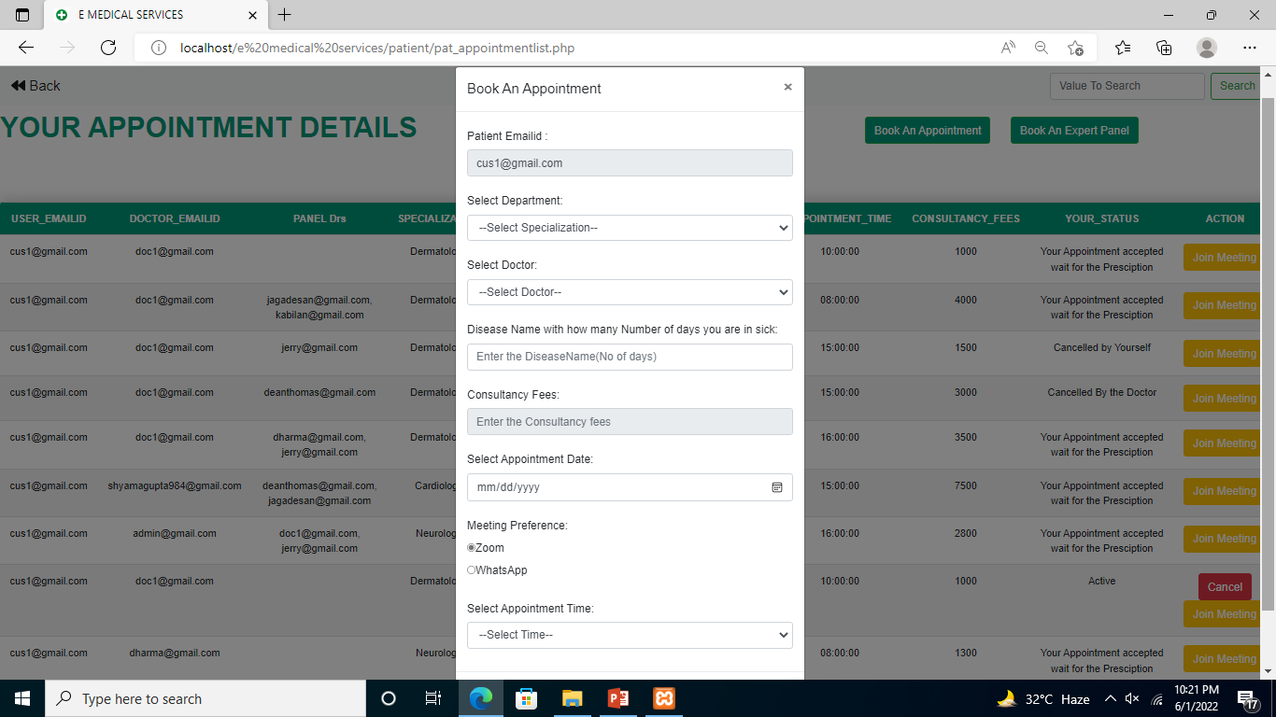
Book an Appointment

Slide 18
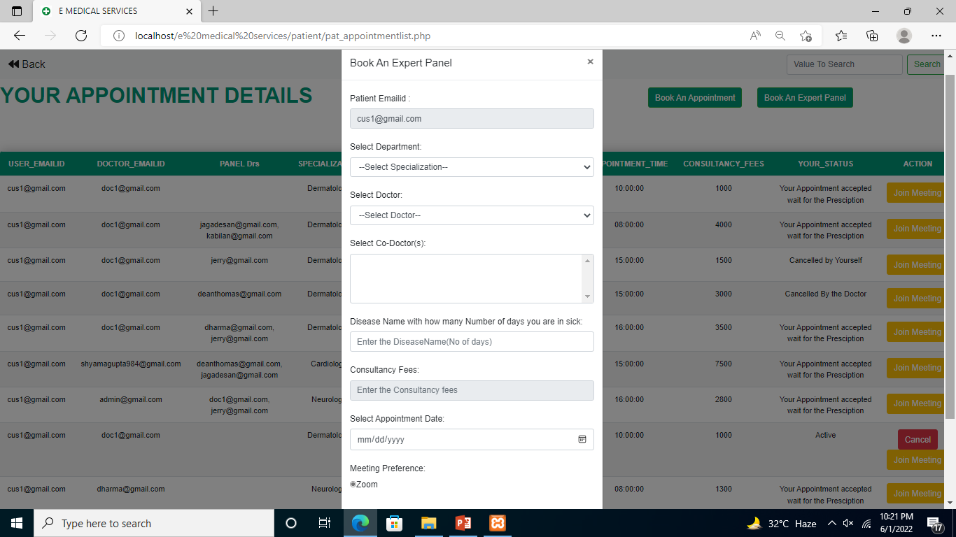
Book an Appointment for Expert Panel

Slide 19
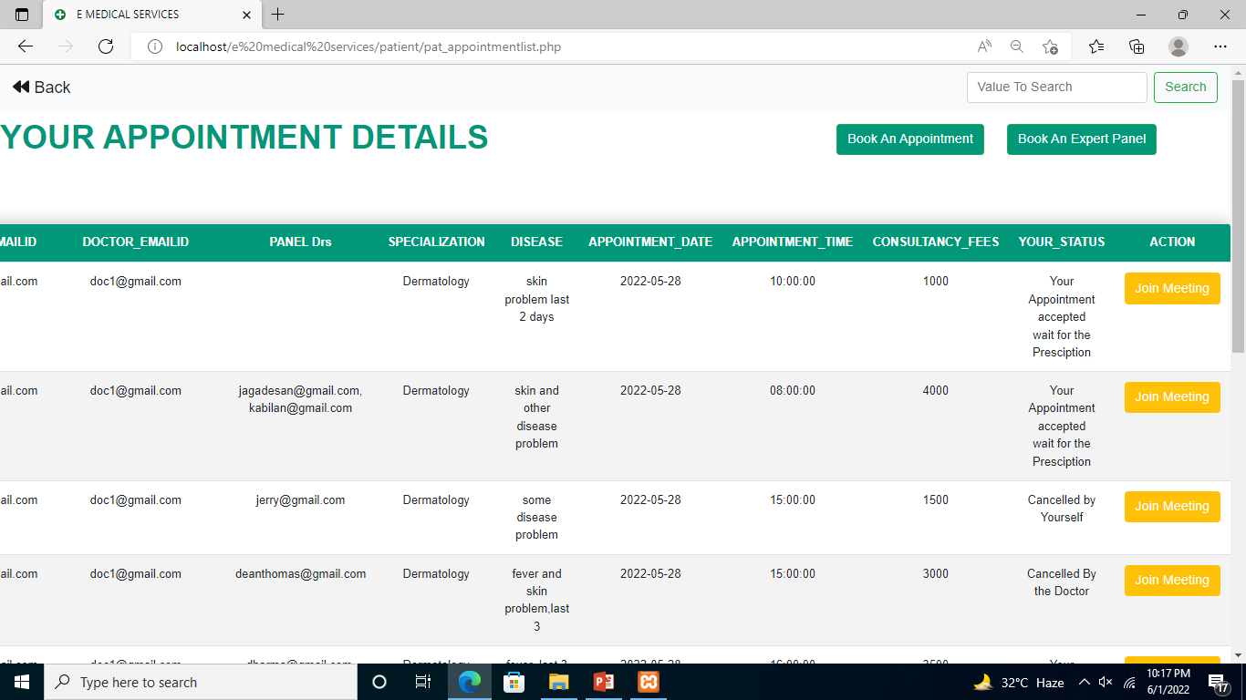
List of Appointments

Slide 20
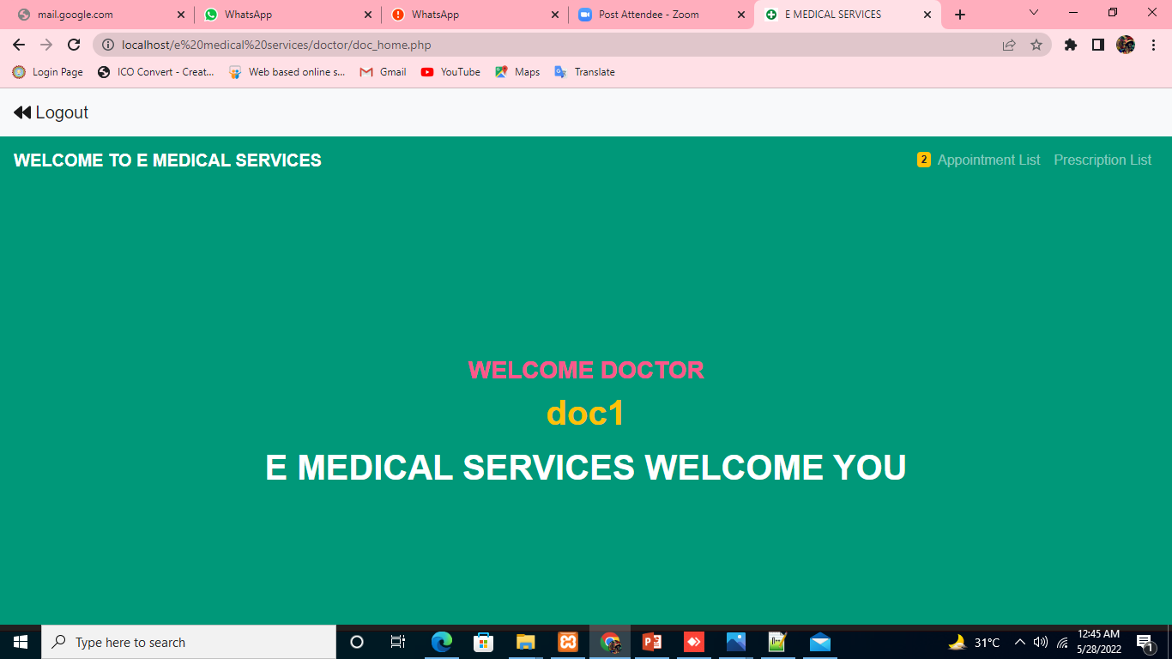
Doctor Portal

Slide 21
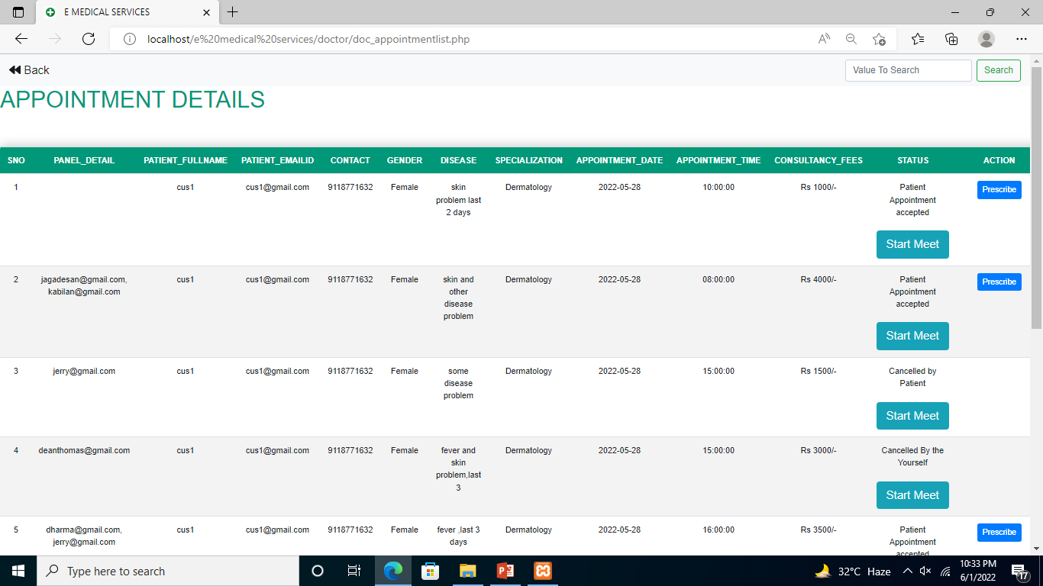
Doctor Can See Appointments

Slide 22
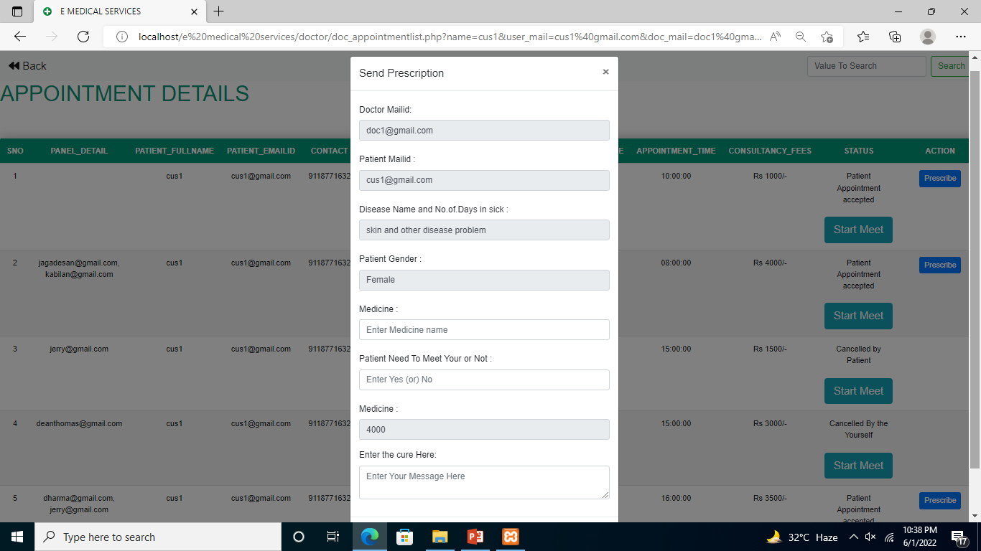
Give Prescription

Slide 23
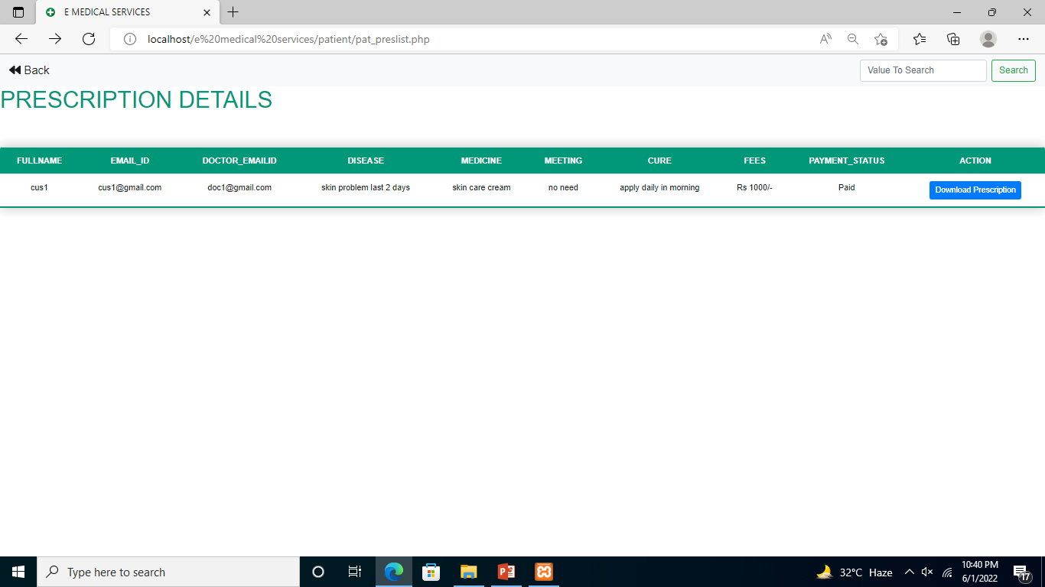
Patients Can Download Prescription

Slide 24
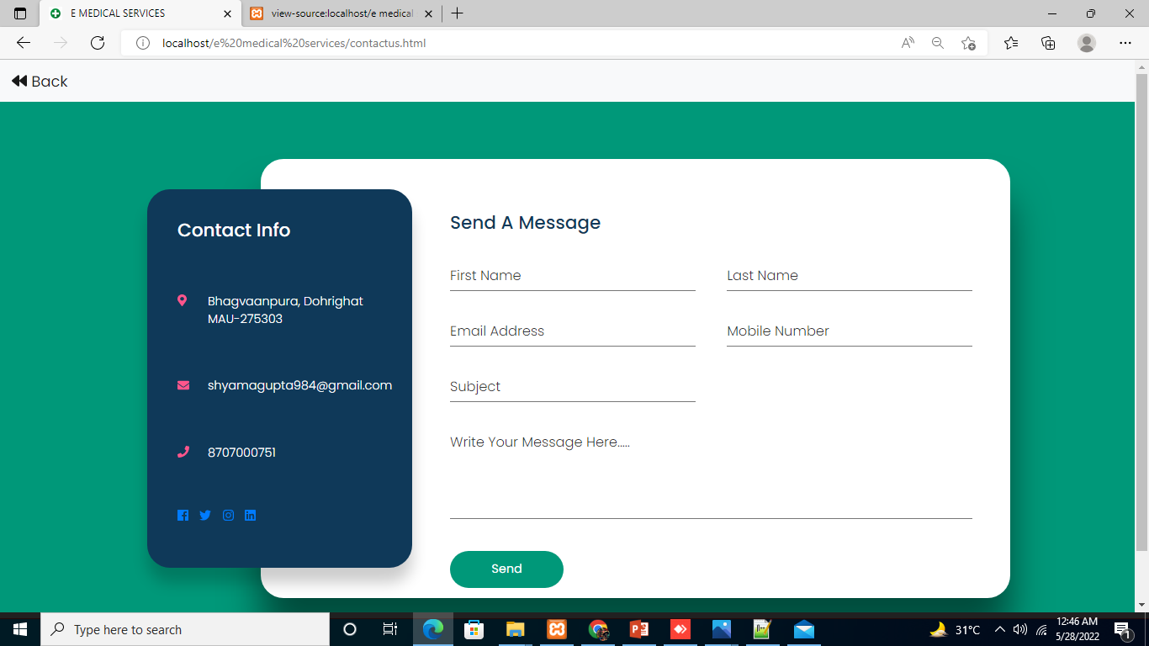
Contact Us

Slide 25
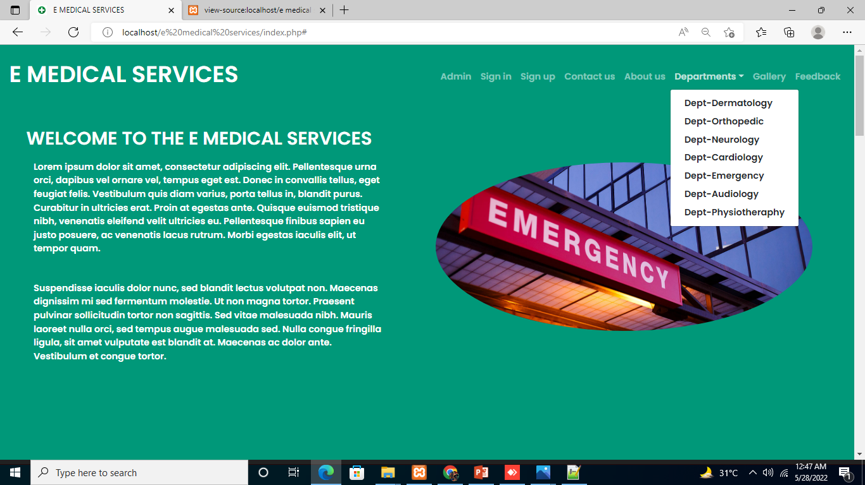
Departments

Slide 26
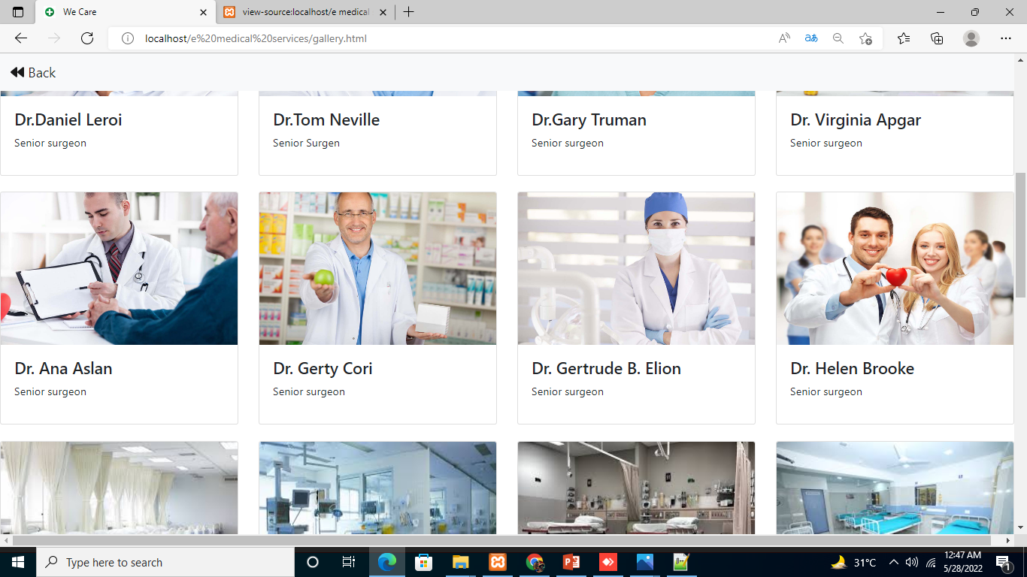
Gallery

Slide 27
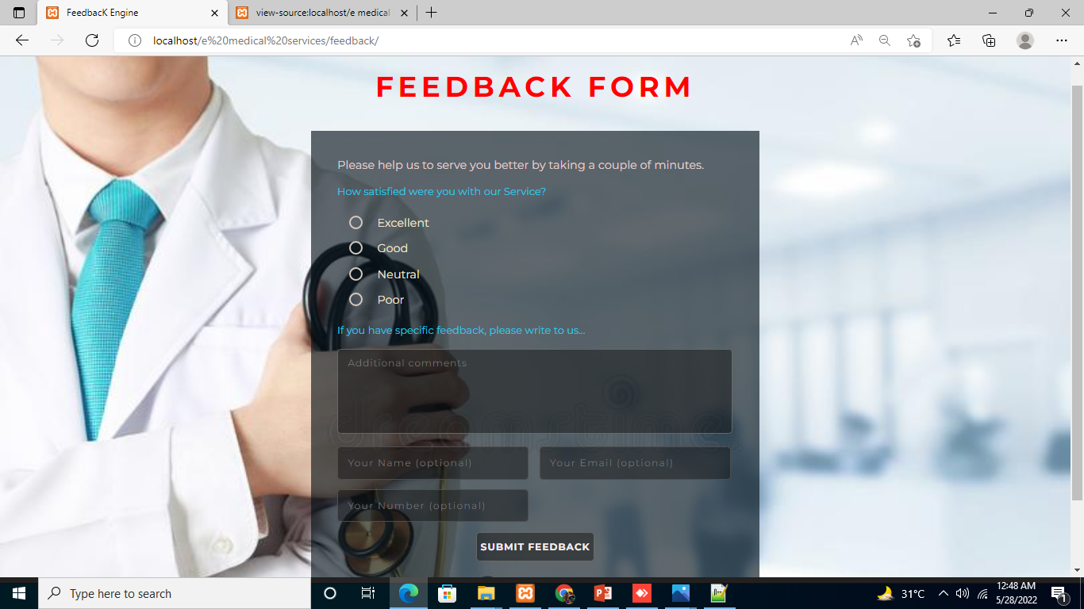
Feedback

Slide 28




Advantages
We can access it from anywhere and book an appointment without going manually.
We can easily search a doctor to particular diseases like Skin-care, Neurology,
Dermatology etc.
This helps to keep records of patients history, medical report, doctors.
It saves our times.

Slide 29
Conclusion
Compared to the usual queuing method, the web based E-Medical Services system could significantly increase patient’s satisfaction with registration and reduce total waiting time effectively. However, further improvements are needed for broad use of the system.

Slide 30
Future Scope
We can give more advanced software for doctor appointment system including more facilities.
Integrated multiple loaders and distribute the loads of the system.
We will host platform on online servers to make it accessible worldwide.

Slide 31
References
[1] T. Foley and F. Fairmichael, “The Potential of Learning Health Care Systems,” The Learning Healthcare Project, 2015. [Online]. Available: https://learninghealthcareproject.org/the-potential-of-learning-healthcare-systems/
[2] Hairudin Abdul Majid, Azurah A Samah , Lizawati Mi Yusuf , Dewi Nasein (2016) “P2P audio and video calling applications using WebRTC”

Slide 32
[3] Raymond Greenlaw, Y. Daniel Liang, in Encyclopedia of Information Systems (2003), “ Sequence Diagrams”[10] Federico Haag (2017) , “ UML Quick Reference”
[4] Federico Haag (2017) , “ UML Quick Reference”
[5] Sixtus Ezenwa Nwawudu (2018), “Design and Implementation of a Hospital Database Management System (HDMS) for medical Doctors” DOI: 10.7763/IJCTE.2018.V10.1190

Slide 33
Thank You!

